Slide 1
Machine Learning Techniques (16CSE09)
Dr.T.Sivakumar, ASP/CSE
Dr.MCET, Pollachi

Slide 2
Course Objective
CO-1: Describe Various ML Approaches
CO-2: Utilize regression and classification algorithms
CO-3: Develop resampling and model selection methods
CO-4: Model data classification using support vector machine
CO-5: Make use of neural network and deep learning algorithms

Slide 3
Text Books
JAMES, WITTEN, HASTILE AND TIBSHIRANI, “AN INTRODUCTION TO STATTISTICAL LEARNING WITH APPLICATION IN R” SPRINGER 2013.
JOSH PATTERSON AND ADAM GIBSON , “DEEP LEARNING : A PRACTITIONER APPROACH” O’REILLY, 2017.

Slide 4
CLASS TIMING
TUESDAY : 11.30 AM TO 12.15 PM
WEDNESDAY : 12.15 PM TO 01.00 PM
THURSDAY : 10.15 AM TO 11.00 AM

Slide 5
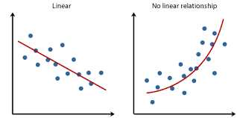
Regression
Regression is a statistical method used in finance, investing, and other disciplines that attempts to determine the strength and character of the relationship between one dependent variable (usually denoted by Y) and a series of other variables (known as independent variables).

Slide 6
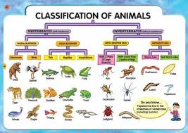
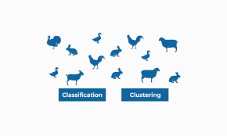
Classification
Classification involves putting things into a class or group according to particular characteristics.
classification refers to a predictive modeling problem where a class label is predicted for a given example of input data.
classify if it is spam or not.

Slide 7
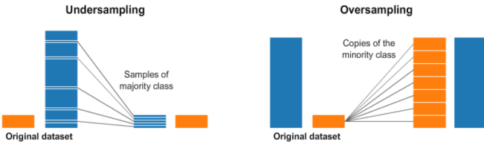
Resampling
Resampling is a methodology of economically using a data sample to improve the accuracy and quantify the uncertainty of a population parameter.
Resampling changes the dataset into a more balanced one by adding instances to the minority class or deleting ones from the majority class, that way we build better machine learning models.
Achieved via two main methods: Oversampling and Undersampling.

Slide 8
Model Selection
Model selection is the task of selecting a statistical model from a set of candidate models.
In model selection tasks, we try to find the right balance between approximation and estimation errors.
Classification uses predefined classes in which objects are assigned, while clustering identifies similarities between objects, which it groups according to those characteristics in common and which differentiate them from other groups of objects. These groups are known as "clusters".

Slide 9
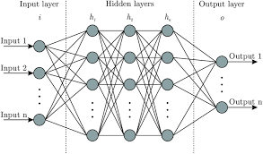
Neural Networks
Neural networks are a series of algorithms that mimic the operations of a human brain to recognize relationships between vast amounts of data.
They are used in a variety of applications in financial services, from forecasting and marketing research to fraud detection and risk assessment.

Slide 10

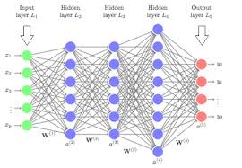
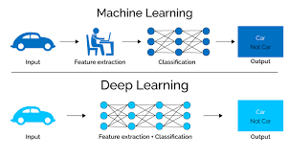
Deep learning
Deep learning is an AI function that mimics the workings of the human brain in processing data for use in detecting objects, recognizing speech, translating languages, and making decisions.

Slide 11
Machine Learning is…
Machine learning, a branch of artificial intelligence, concerns the construction and study of systems that can learn from data.

Slide 12
Machine Learning is…
Machine learning is programming computers to optimize a performance criterion using example data or past experience. - Ethem Alpaydin
The goal of machine learning is to develop methods that can automatically detect patterns in data, and then to use the uncovered patterns to predict future data or other outcomes of interest. - Kevin P. Murphy
The field of pattern recognition is concerned with the automatic discovery of regularities in data through the use of computer algorithms and with the use of these regularities to take actions. - Christopher M. Bishop

Slide 13
Machine Learning is…
Machine learning is about predicting the future based on the past.
-- Hal Daume III
past
future
learn
predict
Training
Data
model/
predictor
Testing
Data
model/
predictor

Slide 14
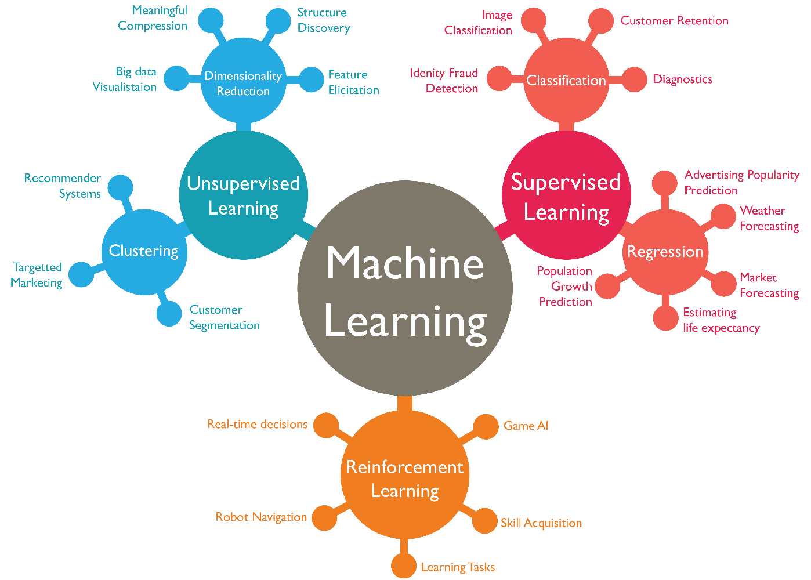

Slide 15
Summary
Introduction to Machine Learning
Meaning of the Key terms:
Classification
Regression
Clustering

Slide 16
Thank You.

